Slide 1
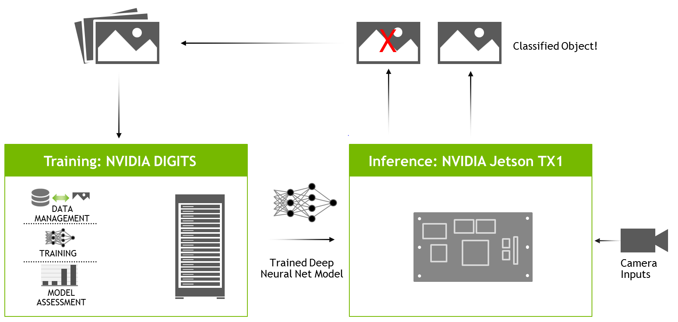
What’s Deep Learning?
Deep-learning networks typically have two primary phases of development: training and inference
Training: DIGITS(the Deep Learning GPU Training System) is a webapp for training deep learning models.
Inference: Using it's trained weights, the network evaluates live data at runtime, the network predicts and applies the examples it learned. Many uses for deploying deep inference, including: image/data/video recognition, object detection, segmentation.

Slide 2
Deploying Deep Learning
Using NVIDIA TensorRT for efficiently deploying neural networks onto the embedded platform.
Vison primitives, such as imageNet for image recognition. The imageNet object accepts an input image and outputs the probability for each class. Having trained on ImageNet database of 1000 objects.
Orange picture, mouse picture

Slide 3
Reference
https://github.com/dusty-nv/jetson-inference#testing-classification-model-in-digits
https://github.com/dusty-nv/jetson-inference/blob/master/docs/deep-learning.md
https://github.com/NVIDIA/DIGITS

